Slide 1







The Stack Overflow Developer Survey 2019
Sumit Salve
November 25, 2022

Slide 2



OUTLINE
Executive Summary
Introduction
Methodology
Results
Visualization – Charts
Dashboard
Discussion
Findings & Implications
Conclusion
Appendix

Slide 3

EXECUTIVE SUMMARY
Relevant skills required in the field of IT and business
consulting are ever-changing and evolving.
It is important to identify future skill requirements and trends to keep pace with changing technologies and remain competitive.
This presentation will show current and future trends in Programming Languages, Databases, Platforms and Web Frames.
Overall, the aim in identifying future skill requirements and trends is to help the firm make more informed data driven hiring and budgetary decisions.

Slide 4

INTRODUCTION
This presentation has been created for stakeholders and business decision makers within the global IT and business consulting services firm.
The presentation will help identify future skill requirements in the global IT sector necessary for the firm to keep pace with changing technologies and remain competitive.
Recommendations will be stated based on the analysis.

Slide 5

METHODOLOGY
Using a modified subset of the Stack Overflow dataset¹, the data was wrangled in order to remove duplicates, impute missing values and normalize data.
Next, the data underwent exploratory analysis in order to find the distribution of data, presence of outliers and determine the correlation between different columns in the dataset.
The data was then used to visualize the distribution, the relationship between two features and the composition and comparison of data.
Finally, after downloading two files², which are also a modified subset of the StackOverflow dataset, Cognos Dashboard Embedded (CDE) was used to create the “Current Technology Usage”, “Future Technology Trends” and “Demographics” slides.
Appendix
To obtain average annual salaries web scraping was used to extract information from a website then saved to a csv file.

Slide 6
RESULTS

Slide 7
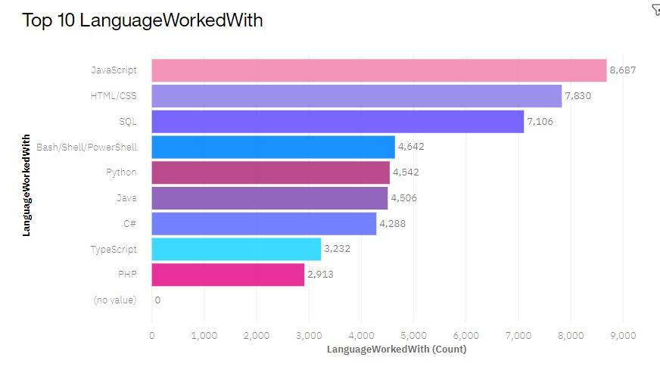
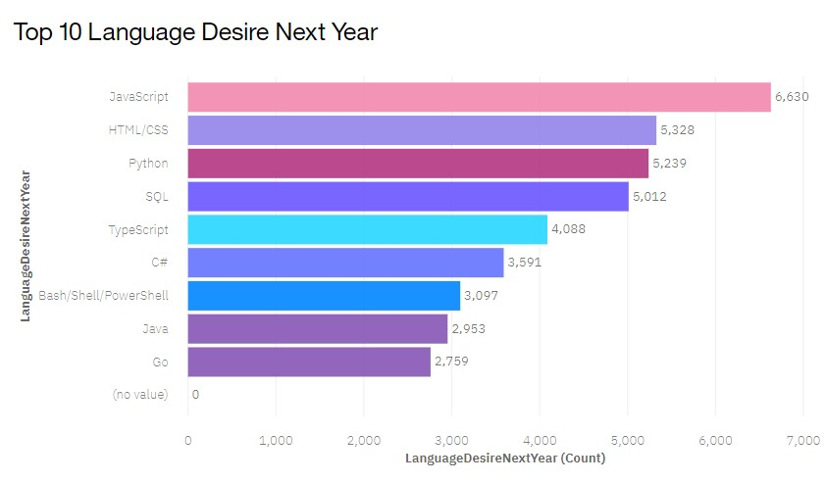
PROGRAMMING LANGUAGE TRENDS
Current Year
Next Year

Slide 8
PROGRAMMING LANGUAGE TRENDS - FINDINGS & IMPLICATIONS
Findings
• JavaScript and HTML/CSS
continue to be the top two most
popular programming languages
for this year and next.
• Python and TypeScript have
gained more interest for next
Year.
• Whereas interest in
SQL and Bash/Shell/PowerShell
has decreased.
Implications
Continue to employ a similar number of people skilled in JavaScript and HTML/CSS.
Employ more people skilled in Python and TypeScript.
Employ less people skilled in SQL and Bash/Shell/PowerShell.

Slide 9
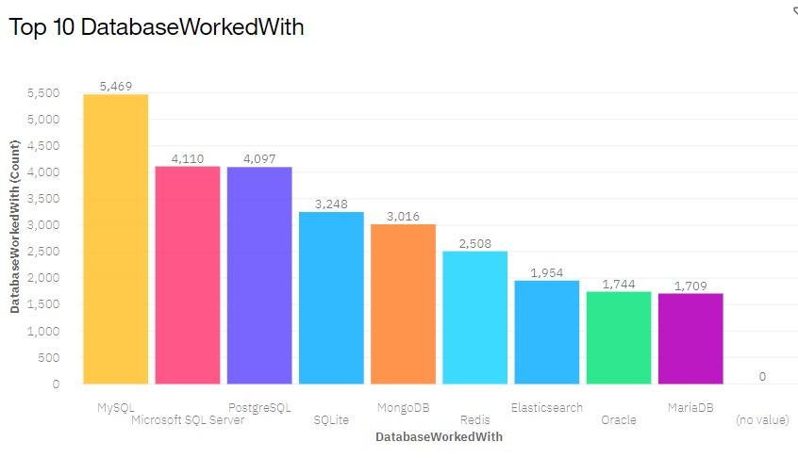
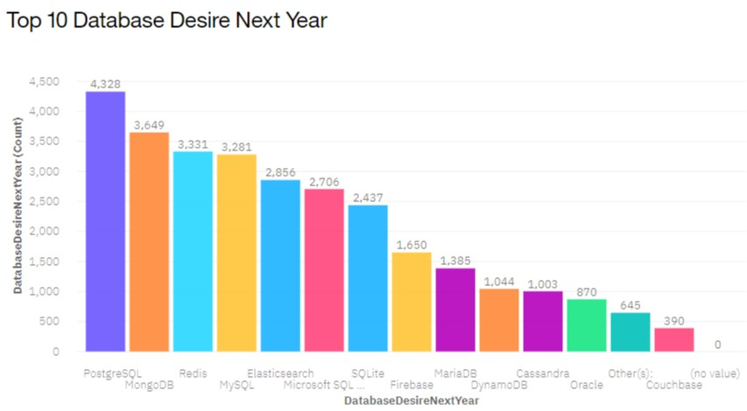
DATABASE TRENDS
Current Year
Next Year

Slide 10
DATABASE TRENDS - FINDINGS & IMPLICATIONS
Findings
• Interest in MySQL, Microsoft
SQL Server and SQLite has
decreased for next year.
• Interest in PostgreSQL and
MongoDB have increased
compared to the current year.
• There is gained interest in
Redis and Elasticsearch for
next year.
Implications
Employ less people skilled in MySQL, Microsoft SQL Server and SQLite.
Employ more people skilled in PostgreSQL and MongoDB.
Employ more people skilled in Redis and Elasticsearch.

Slide 11

DASHBOARD
Dashboard link

Slide 12
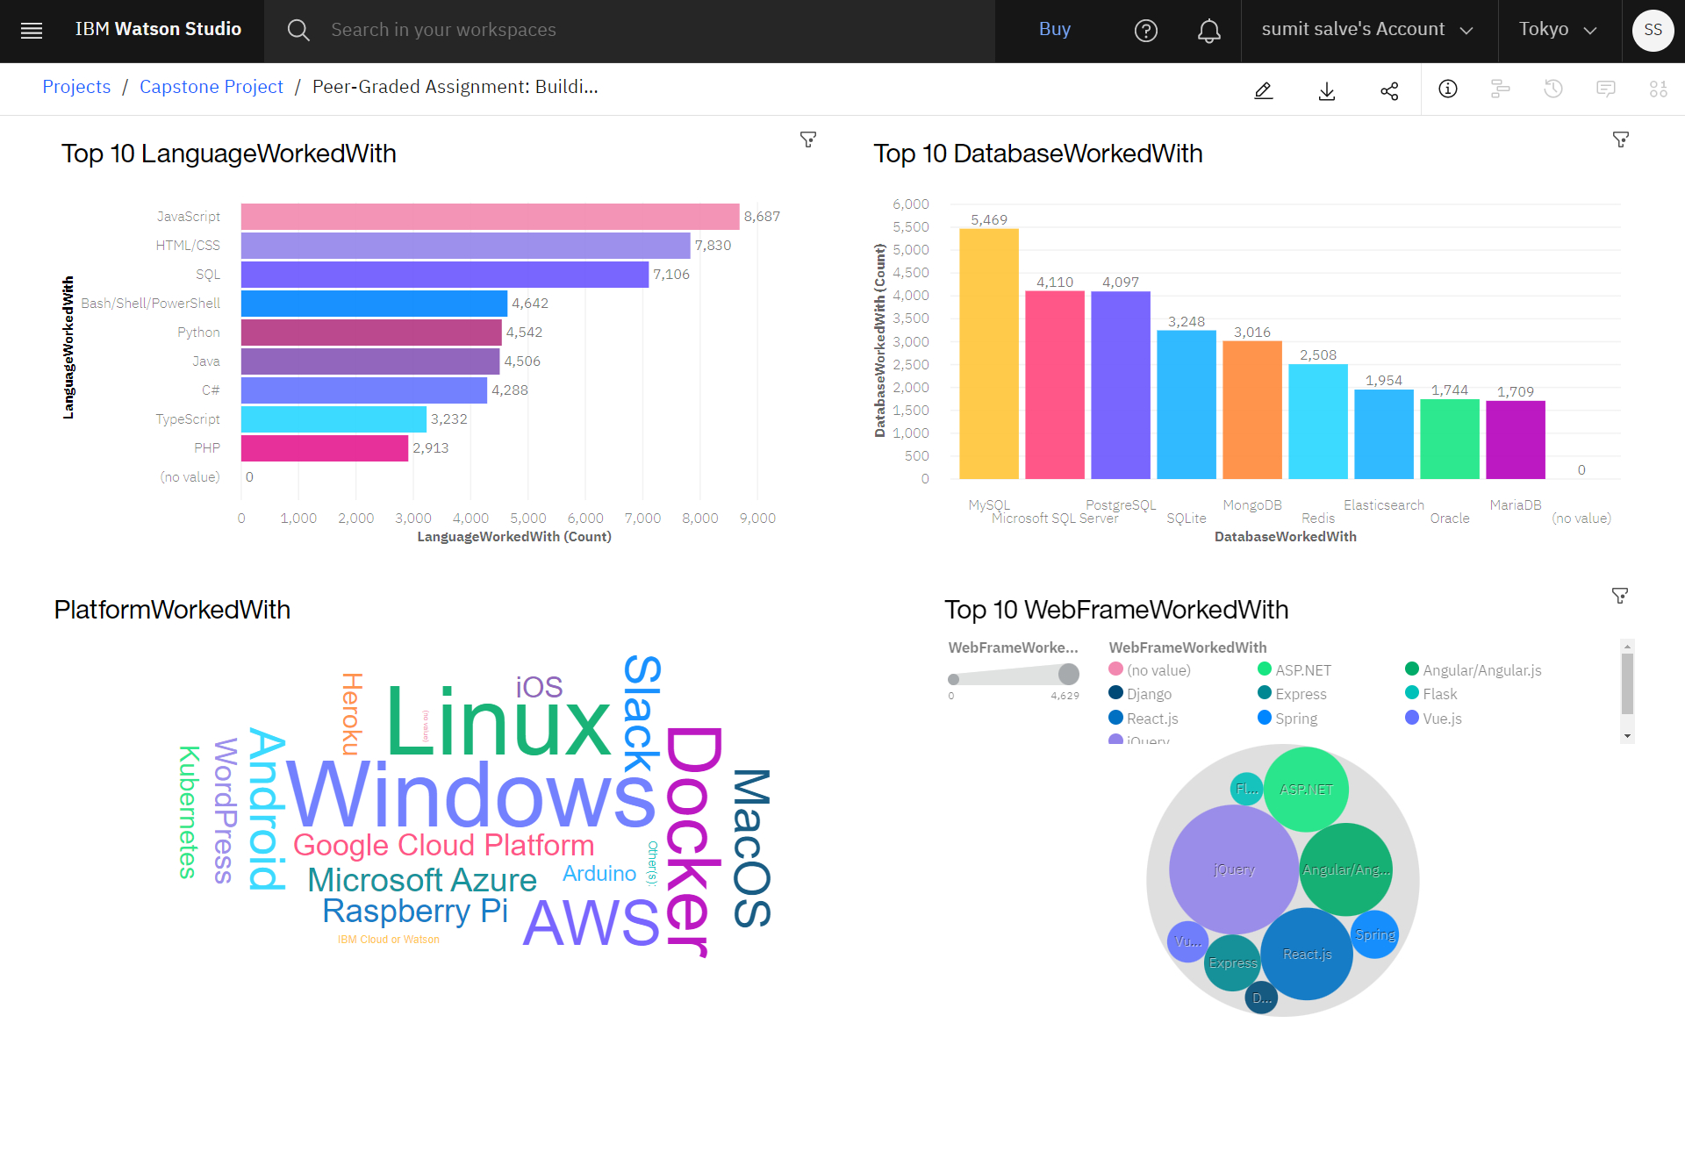
DASHBOARD TAB 1

Slide 13
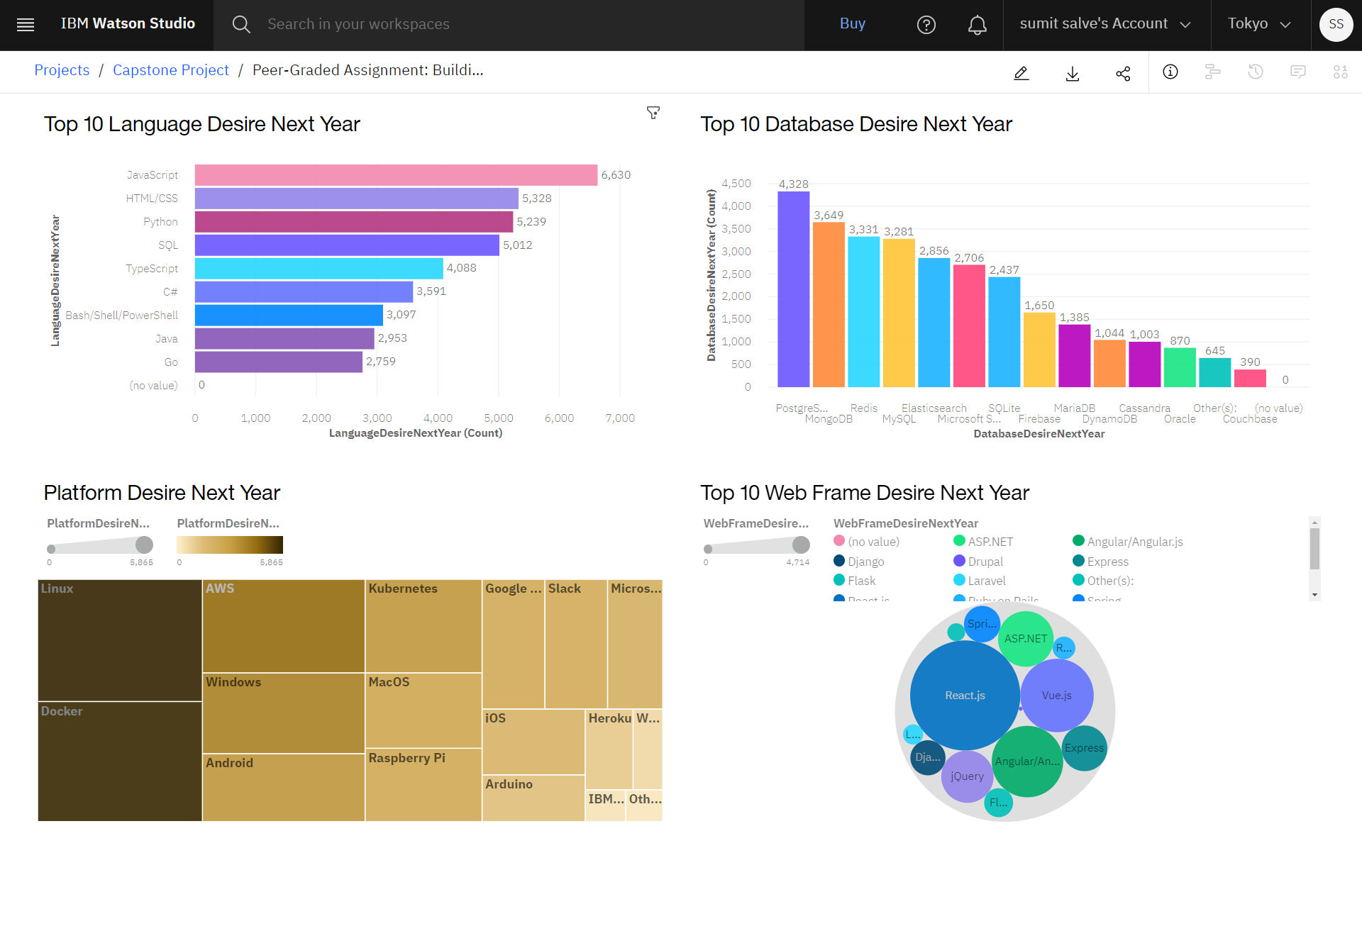
DASHBOARD TAB 2

Slide 14
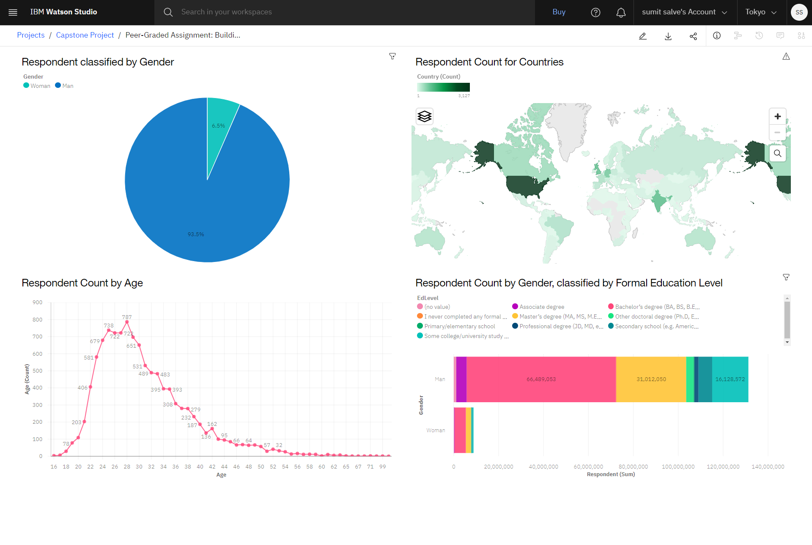
DASHBOARD TAB 3

Slide 15
DISCUSSION

Slide 16
OVERALL FINDINGS & IMPLICATIONS
Findings
• Programming Languages- TypeScript is gaining significant interest and Python continues to grow as well.
•Databases- Redis, Elasticsearch, PostgreSQL and MongoDB are gaining more interest.
• Platforms- Interest Slack and Windows is dropping significantly.
•Web Frames- Vue.js is gaining substantial interest and React.js continues to grow as well.
Implications
Continue to staff enough JavaScript and HTML/CSS but employ more people skilled in TypeScript and Python.
Employ more people skilled in Redis, Elasticsearch, PostgreSQL and MongoDB.
Continue to staff enough ASP.NET but employ more people skilled in Vue.js and React.js.
Continue to staff enough Linux, employ more people skilled in Docker, AWS and Android, but make reductions to Slack and Windows.

Slide 17

CONCLUSION
Carve out budget in order to hire additional staff with skills needed to fill any gaps.
Set aside budget or put a program in place to upskill those already employed.
Make adjustments in staff for those skills no longer in demand.

Slide 18

APPENDIX
RESOURCE:
The 2019 Stack Overflow Developer Survey Results
m5_survey_data_demographics.csv
and m5_survey_data_technologies_normalised.csv
Dashboard

Slide 19
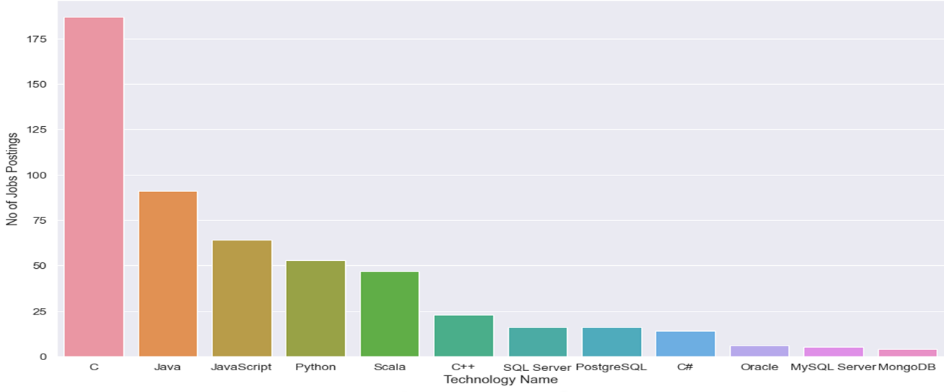
JOB POSTINGS

Slide 20
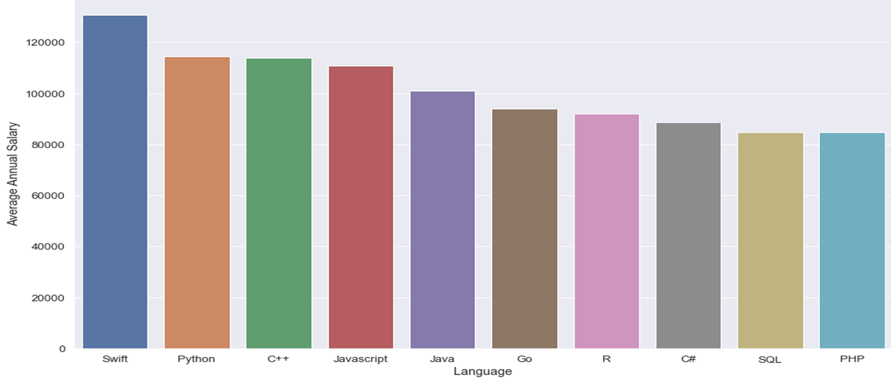
POPULAR LANGUAGES

Slide 21
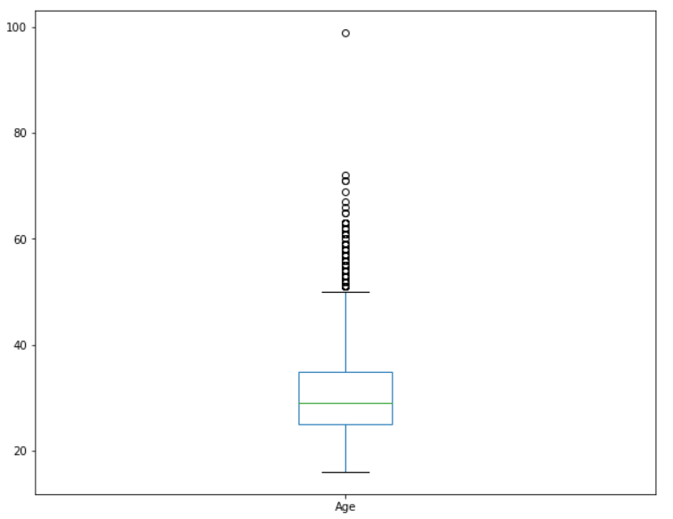
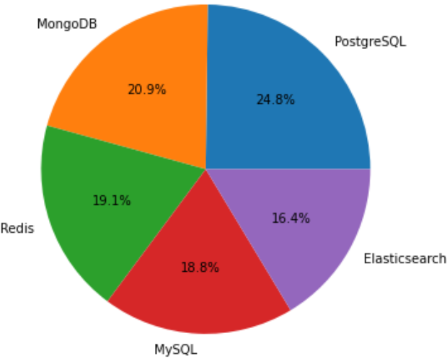
ADDITIONAL VISUALS
Plot a box plot of Age.
Pie chart of the top 5 databases that respondents wish to learn next year.

